Slide 1
Yelp Data Analysis for Bars

Slide 2
1.
Introduction

Slide 3
Introduction
Focus on Bars and Nightlife
Focus on Business in four cities
City | Madison | Phoenix | Charlotte | Pittsburgh
Num of Businesses | 397 | 1074 | 892 | 811
Num of Reviews | 29688 | 141447 | 76584 | 59660

Slide 4
2.
Sentiment extraction and Testing

Slide 5
Some General Problems
Huge amounts of features
Good comments in Low star reviews, and vice versa
High frequency words does not make sense.
Solution ?
Detail Analysis with sentiments !

Slide 6
What kinds of features ?
Food
Burgers, fries, chicken stripes, mozzarella sticks, etc.
Drinks
Beer, spirits like vodka, cocktails like mojito
Service
Waiter and waitress, parking, restroom, etc.
Atmosphere
Music, band, light, etc.
Reference Links: The 50 best-selling cocktails in the world in 2019
The Unofficial Bar Snack of Every State

Slide 7
Sentence tokenizing
Sentence without transition
Review
Sentence

Slide 8
Positive and negative
Total Words Count
Positive words
Negative words

Slide 9
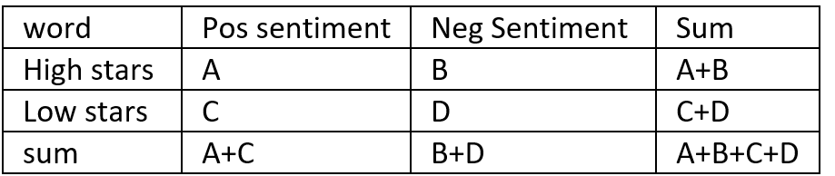
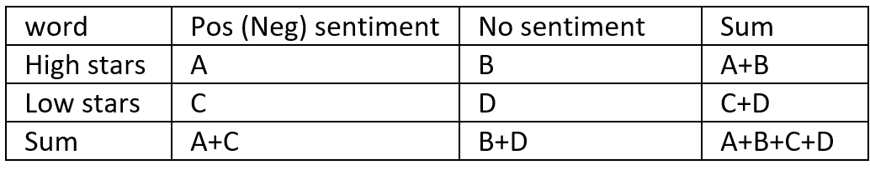
Significant Test : burger for example
Welch’s T-test
first group:
review stars of a word positively mentioned
second group:
review stars of a word negatively mentioned.
Pearson's chi-squared test
Fisher’s exact test

Slide 10
3.
Recommendation System

Slide 11
Focus on significant key words of four categories: foods, drinks, service and atmosphere
For the number of reviews, we use 30 as a threshold
If most of mentions with attitude in reviews are positive, then we note it as a positive feature.
If most of mentions with attitude in reviews are negative, then we note it as a negative feature.
The recommendation is city-specific

Slide 12
For Customers
For foods and drinks, our recommendation system will let customers know which food or drink is positively featured or negatively featured
For service part, it will let customers know if there are good or bad waiter/waitress, Wi-Fi, whether there is enough parking lots or not, whether the restroom is nice.
For atmosphere part, it will let customers know if there are good or bad music, band, environment, atmosphere.

Slide 13
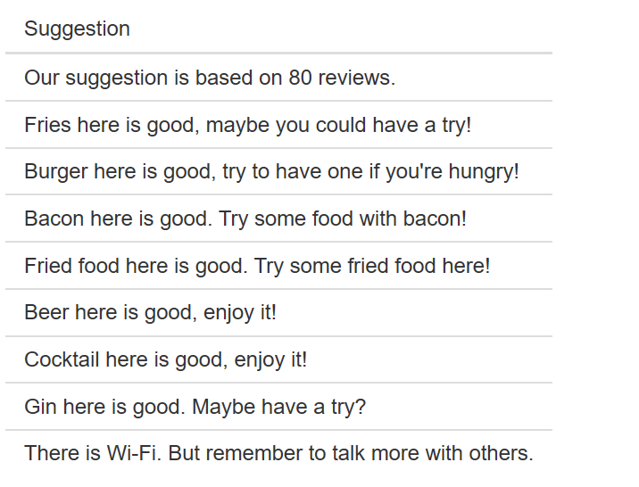

Slide 14
For business
Our recommendation systems will let business know whether there is some positive or negative impression for foods, drinks, service and atmospheres. And also from what aspects, the business can improve it.

Slide 15
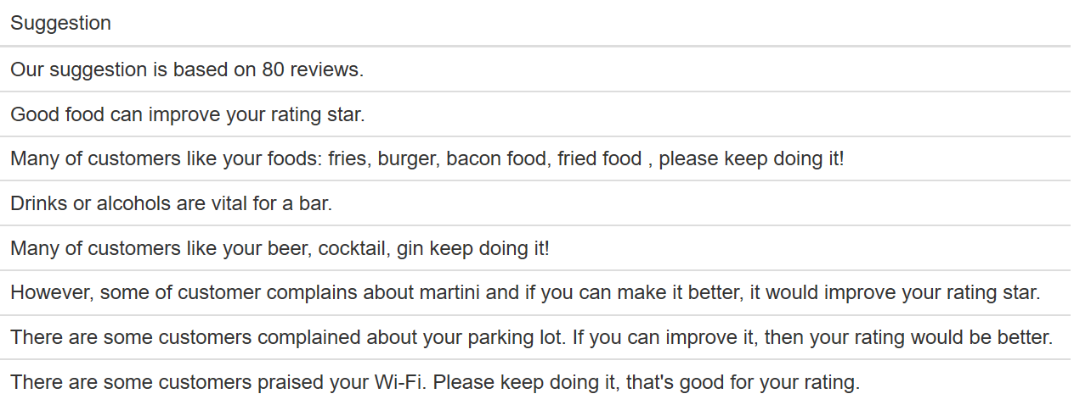

Slide 16
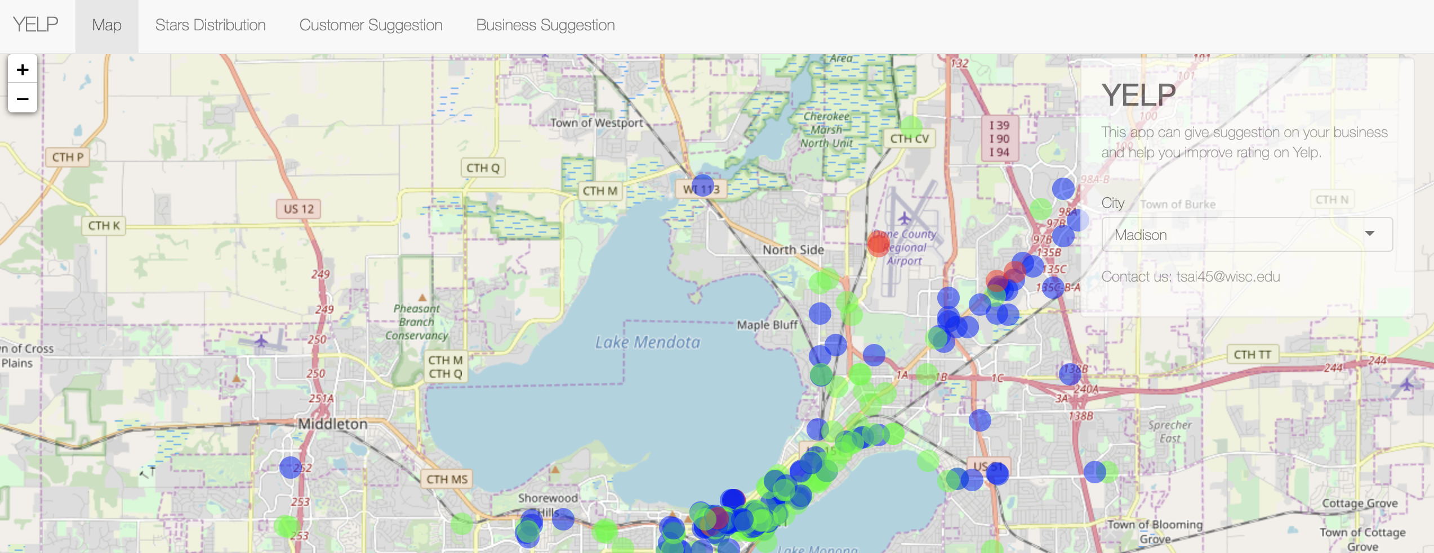
https://manu200921.shinyapps.io/yelp/
Place your screenshot here

Slide 17
4.
Conclusion

Slide 18
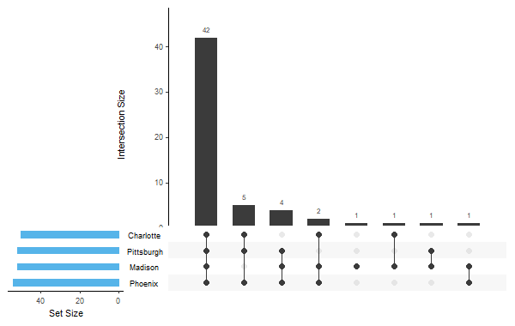
Upset plots of Positive key words

Slide 19
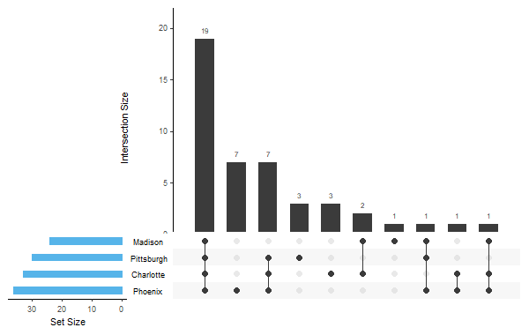
Upset plots of Negative key words

Slide 20
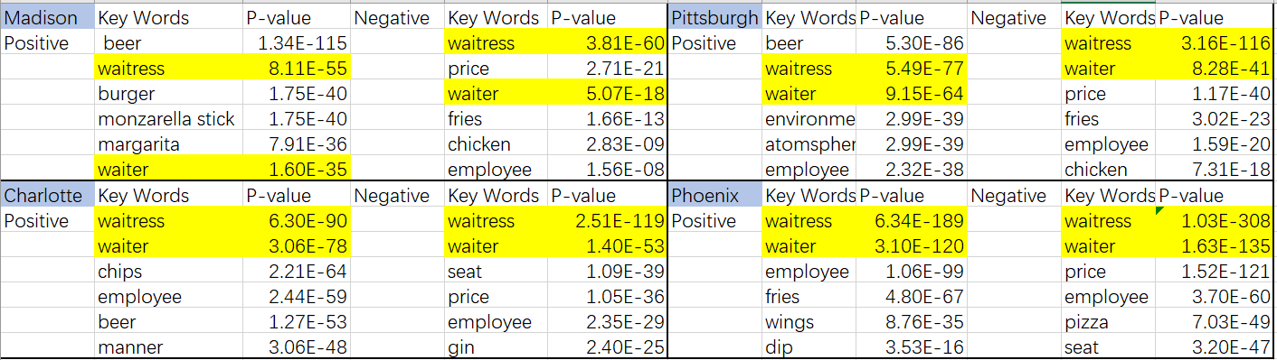
Glance of top key words for each city

Slide 21
Positive keywords
For Madison, customers don’t care about sauce, price, light, environment, and atmosphere.
For Pittsburgh, customers don’t care about sandwich, spark, negroni, brandy and booking.
For Charlotte, customers don’t care about negroni, sandwich, cheese, chicken daiquiri, manhattan and wine.
For Phoenix, customers don’t care about sandwich, brandy and wine.

Slide 22
Negative keywords
For Madison, customers don’t care about sauce, price, light, environment, and atmosphere.
For Pittsburgh, customers don’t care about negroni, margarita, popcorn, rum, booking.
For Charlotte, customers don’t care about wine
For Phoenix, customers don’t care about negroni, popcorn and booking.

Slide 23
Pros and Cons
Strengths:
Our model is concise and robust since we have four tests on each word's significance.
Our analysis not only compare positive sentiment with negative sentiment, but we also add no sentiment into comparation.
Our project not only analysis data business-wise but also city-wise.
The shinny app is very user friendly and beautiful.
Weakness:
Word list could be enlarged, then we can extract more information.
The adjective list of positive words and negative words can also be enlarged, since there might be some positive sentiments and negative sentiments that we have missed.
Our model can't predict reviews stars based on reviews.
We only analysis four cities, and we could add more cities in our project.

Slide 24
Thanks!

